Slide 1
PHS 2000 Econometric Methods 2025 Lecture 6 DID – Advanced topics
Maggie McConnell
Department of Global Health and Population
Harvard T. H. Chan School of Public Health

Slide 2
Plan of presentation
Difference in Differences assumptions
Examples
Clustering and standard errors
Contrasting difference in differences approach with interrupted time series
Advanced topics in difference in differences
Synthetic control
My office hours: after class (starting at 115pm), Building 1 Room 1217

Slide 3
Key assumptions: Counterfactual
Key assumption in Difference-in-Differences
Treatment group would have followed the same trajectory as the control group in the post-intervention period if the intervention had not occurred
This counterfactual is not testable

Slide 4
Formal difference in differences assumptions
Laura Hatfield has created a terrific website that provides a lot of formal detail surrounding difference in differences for health policy:
https://diff.healthpolicydatascience.org/
This website includes simulations you can play around with different assumptions and what they mean
Also contains lots of technical details about the different formal assumptions of DiD

Slide 5
Challenge: functional form dependence
Magnitude and sign of the DiD estimator can be sensitive to functional form
DD using level changes
DD using log changes
 | Treatment | Control
Before | 15 | 5
After | 25 | 10
Change | 25 – 15 = 10 | 10 – 5 = 5
DD | 10 – 5 = 5
 | Treatment | Control
Before | log(15) | log(5)
After | log(25) | log(10)
Change | log(25) -log(15) | log(10) – log(5)
DD | -0.182
Adapted from Duflo

Slide 6
Challenge: mean reversion
Often treatments/programs are targeted based on pre-existing differences in outcomes
In fact this may be why some regions are chosen to participate in the program
If outcomes have a natural tendency to mean reversion, comparing outcomes of treated to non-treated regions leads to biased estimates of the treatment effect

Slide 7
Key assumptions: No Contamination
Stable unit treatment value assumption (SUTVA).
We require that "the observation on one unit should be unaffected by the particular assignment of treatments to the other units“
If there is spillover from treatment to control areas due to the intervention this will be violated
What kind of spillovers would you worry about for a study on the impact of Medicaid expansion?
Using US states in health studies
Contamination due to infectious disease spread
Movement of people to get access to policy benefits
Movement of health care providers in policy response

Slide 8
Difference in Difference estimation tips
Show lots of figures
Most reviewers want to see evidence of parallel pre-trends
Event study can be a nice way to show this
Demonstrate no major differential compositional changes in population of treatment or control in post period
Do placebo/falsification tests
Fake time period for policy introduction
Outcome that shouldn’t be affected by treatment
Show impact estimates with and without controls
Controls only need to be group*time varying (all others will fall out of the regression because of group and time fixed effects)
Ideal to control for presence of other programs that might have influenced outcome and show that the impact estimate doesn’t change

Slide 9
Valid standard errors: Small number of groups
With many groups, clustering the standard errors at the group level works well to allow for intracluster correlation
With a small number of groups, this is not a good approach
Can actually lead to standard errors that are too small
Could instead average the data across groups but this will severely limit power
Can use bootstrap/placebo methods but more complex
“Wild” Bootstrap – use boottest in STATA implements Cameron et al 2008
Construct placebo intervention data based on random assignment of intervention to groups and construct test statistics based on the distribution of outcomes for placebo interventions
Can work with as few as 6 groups

Slide 10
Valid standard errors: Autocorrelation
With autocorrelation, observations for the same group will be correlated over time
Observations of multiple time points pre- and post-intervention will not be independent and do not add much additional information
With a large number of groups, clustering the standard errors across time within the same group can correct for autocorrelation
We can also estimate the autocorrelation structure, but very biased estimates with group fixed effects and small number of periods

Slide 11
Difference-in-Differences vs. Interrupted Time Series
Conceptually similar: both used to estimate the effect of group level interventions by creating a counterfactual; what would have happened without the intervention
Structural differences
ITS uses aggregated data with one treated area time series whereas Difference-in-Differences usually keeps the data at the individual level and adjusts for within-group correlation.
ITS has one treatment group (and one control group in CITS) while Difference-in-Differences works well with multiple treated and control groups
ITS fits a (usually linear) time trend and extrapolates counterfactual whereas Difference-in-Differences uses time fixed effects and uses control group to generate counterfactual
ITS will be favored when change is expected to be immediate and large. DiD methods are better for changes that may be more subtle or phase in over time

Slide 12

DiD is a fast evolving method
Today we will discuss some new developments in difference in differences
The conversation will not be comprehensive
The landscape is continuously evolving so can be challenging to stay up to date
Check recent review papers for discussion of ”state of the art” methods

Slide 13
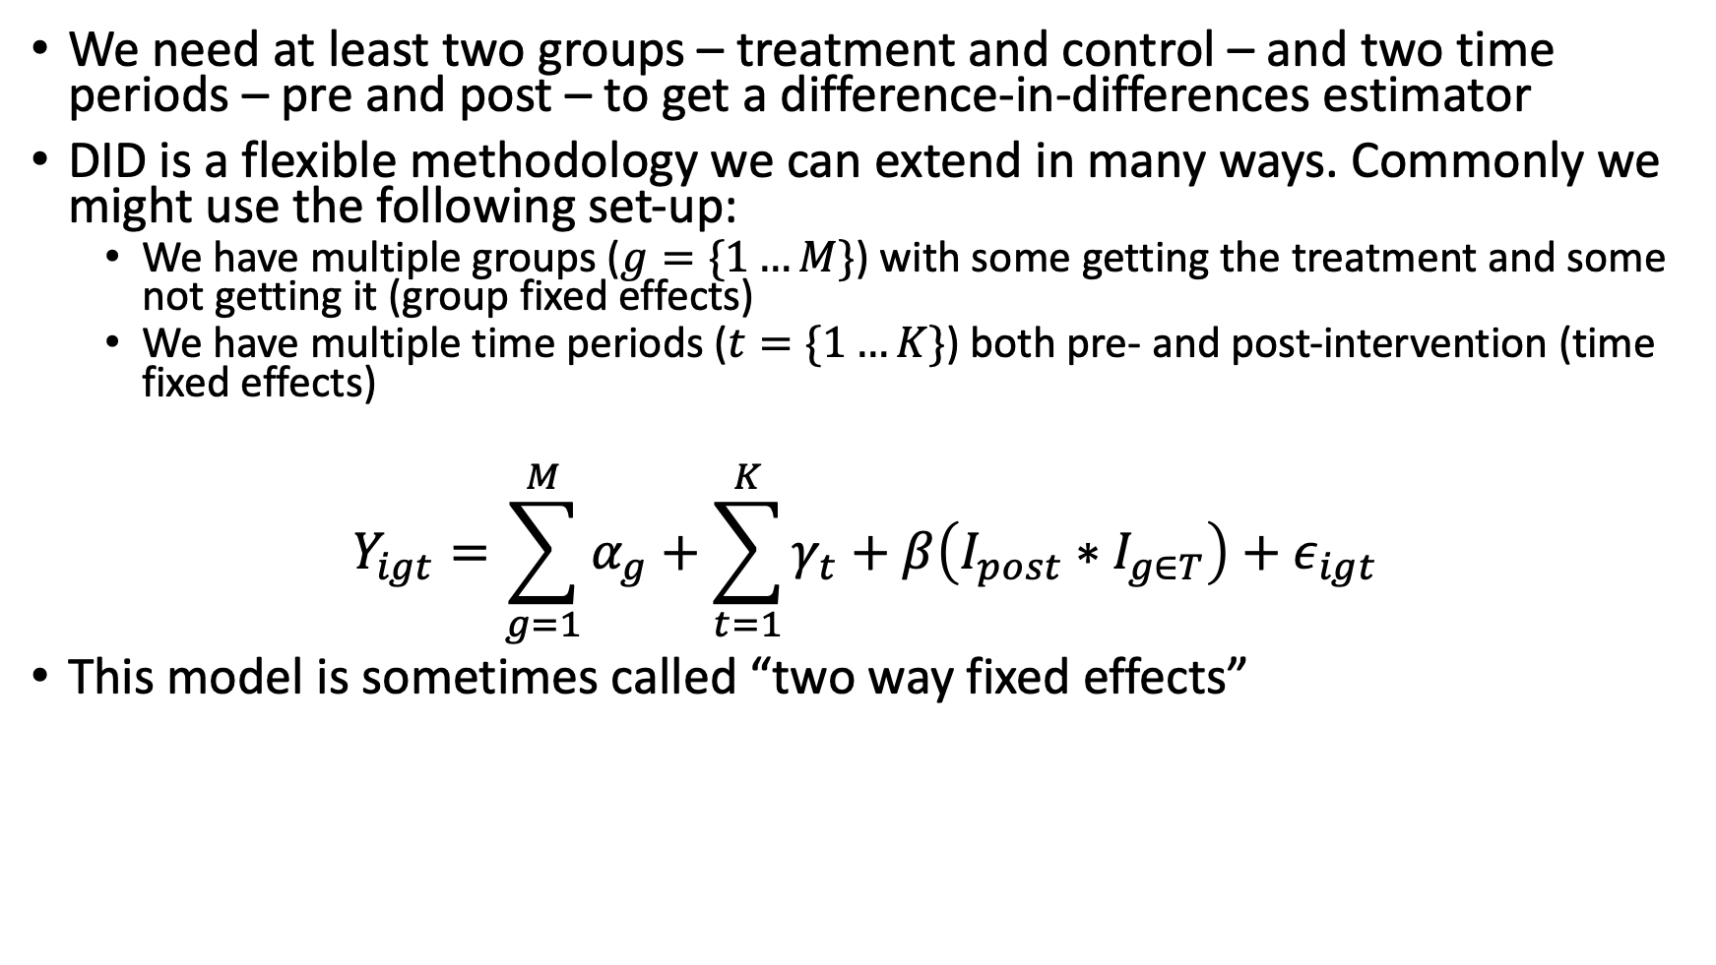
Recap – two way fixed effects model
We need at least two groups – treatment and control – and two time periods – pre and post – to get a difference-in-differences estimator
DID is a flexible methodology we can extend in many ways. Commonly we might use the following set-up:
We have multiple groups ($g=\{1…M\}$) with some getting the treatment and some not getting it (group fixed effects)
We have multiple time periods ($t=\{1…K\}$) both pre- and post-intervention (time fixed effects)
$$Y_{igt}=\sum_{g=1}^{M}{α_{g}}+\sum_{t=1}^{K}{γ_{t}}+β\left(I_{post}∗I_{g∈T}\right)+ε_{igt}$$
This model is sometimes called “two way fixed effects”

Slide 14
Examples of staggered rollouts
Medicaid expansion under the Affordable Care Act
Closures of Social Security offices that help process Supplemental Security Income
Changes to the Earned Income Tax Credit at the state level
Treatment starts at different time in different groups

Slide 15
Staggered rollout DiD design
Consider a model where different states adopted a treatment at different times and you are using two-way fixed effects (group and time fixed effects) to estimate treatment effects
It turns out you can decompose DiD estimator into a weighted average of all possible two-by-two difference-in-differences estimators that can be constructed from your data

Slide 16
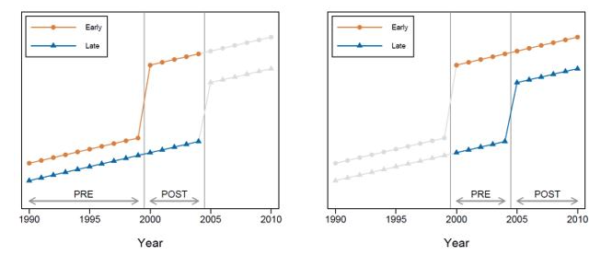
Example
Imagine you are looking at the impact of transitioning to free primary schools
Some states are early adopters and some adopt later
DiD estimator is a weighted average of:
comparisons between early adopters and later adopters over the periods when the later adopters are not yet been treated
comparisons between early adopters and later adopters over the periods when the early adopters are treated – they become comparison group for the later adopter
comparisons between different timing groups (e.g., early adopters or later adopters) and the never-treated (not pictured)

Slide 17
Implications
Difference in difference designs only recover average treatment effects when treatment effects are homogeneous
When treatment effects change over time DiD will provide biased estimates of treatment effect
This is because the DiD estimator uses already treated units as controls for future treated units
When would it be a problem to use already treated as controls for later treated?
If outcomes in already treated units continue to react to treatment, they make bad controls
Luckily – there are econometric strategies to address this!
Many of them attempt to avoid comparisons to “forbidden controls”
Various approaches summarized in What’s Trending in Difference-in-Differences? A Synthesis of the Recent Econometrics Literature
A discussion of considerations for publication in public health journals available here: Difference-in-Differences for Health Policy and Practice: A Review of Modern Methods

Slide 18
Useful default: “Saturated” models
“Saturated” models involve a full set of fixed effects
Group, time and group by time
Estimate separate “treatment effects” for each post-intervention time period
This mitigates some of the problems when treatment effects are time-varying
Some have argued that fully saturated models become the “default” difference in difference method

Slide 19
Solution to problems introduced by “staggered adoption”
Many different estimators have been developed to deal with problems introduced by staggered adoption
Callaway–Sant’Anna: compare treated only to valid controls, then aggregate
Sun–Abraham: fixes event-study bias from staggered timing
Borusyak et al: predicts untreated outcomes, compares to reality
de Chaisemartin & D’Haultfoeuille: reweight comparisons to avoid bias

Slide 20
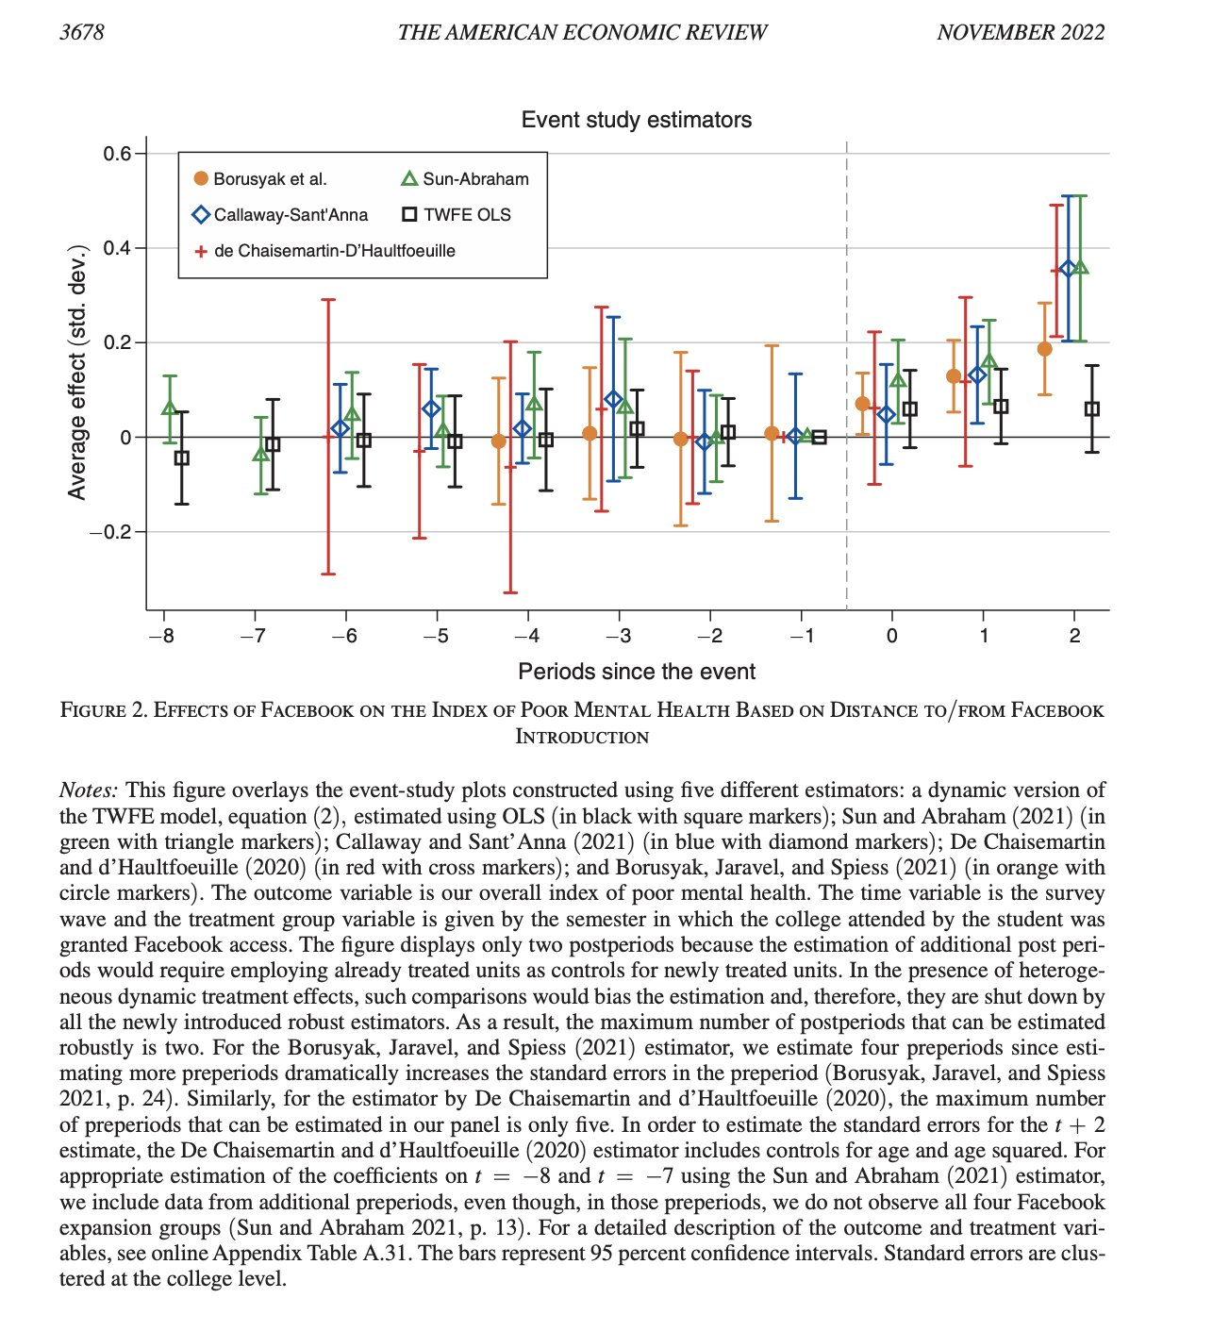
Many methods – how to handle? Economics strategy: Estimate using different estimators – demonstrate robustness to model specification Braghieri et al 2022, Social Media and Mental Health Question: what is the impact of the availability of facebook on poor mental health Strategy: Uses the rollout of Facebook across US colleges as the “treatment”

Slide 21
Another Solution: Stacked Difference in Differences
Create “subsets” of the data for every policy “event”
Each subset contains the treated unit and all untreated comparison units over fixed intervals (i.e. 20 months before the policy change and 20 months after)
Removes the “forbidden controls” problem

Slide 22
Moving on to synthetic control

Slide 23
Synthetic control -- Intuition
Intuition – we are trying to find a control group that is similar to treated group in pre-treatment period
Similar covariates that affect the outcome
Similar values of the outcome
Helps with the plausibility of the counterfactual
The treatment group would have followed the path of the control group if it had not been treated in the post-intervention period
We may try to find this as a naturally occurring phenomena
Sometimes this isn’t possible – especially with just one treatment group and few control options
If researchers can ”chose” their preferred control group – many options for cherry picking a control group that gives a desired outcome
The idea of synthetic control is to “create” this control group using a data driven and transparent process

Slide 24
Synthetic control – How it works
To create a synthetic control we use weighted average of possible control groups as counterfactual
Weights tells us which control units (“donors”) contribute the most to the counterfactual
We get to see weights – decide if they are intuitive
Choose weights to match outcome and covariates in the treated group during the pre-interventional period
We can perfectly replicate pre-trends in the treated group
Counterfactual – treated group would have continued in the same way as the synthetic control in the absence of treatment

Slide 25
Synthetic control
Weights chosen so that the weighted average of the untreated control units (or donors) most perfectly matches the pre-treatment trends in the treated unit
Weights (usually) constrained to be non-negative and sum to 1.
Negative weights can give better fit – but difficult to interpret and imply extrapolation → treated group predicted outcome predicted to move up when negative weight group moves down

Slide 26
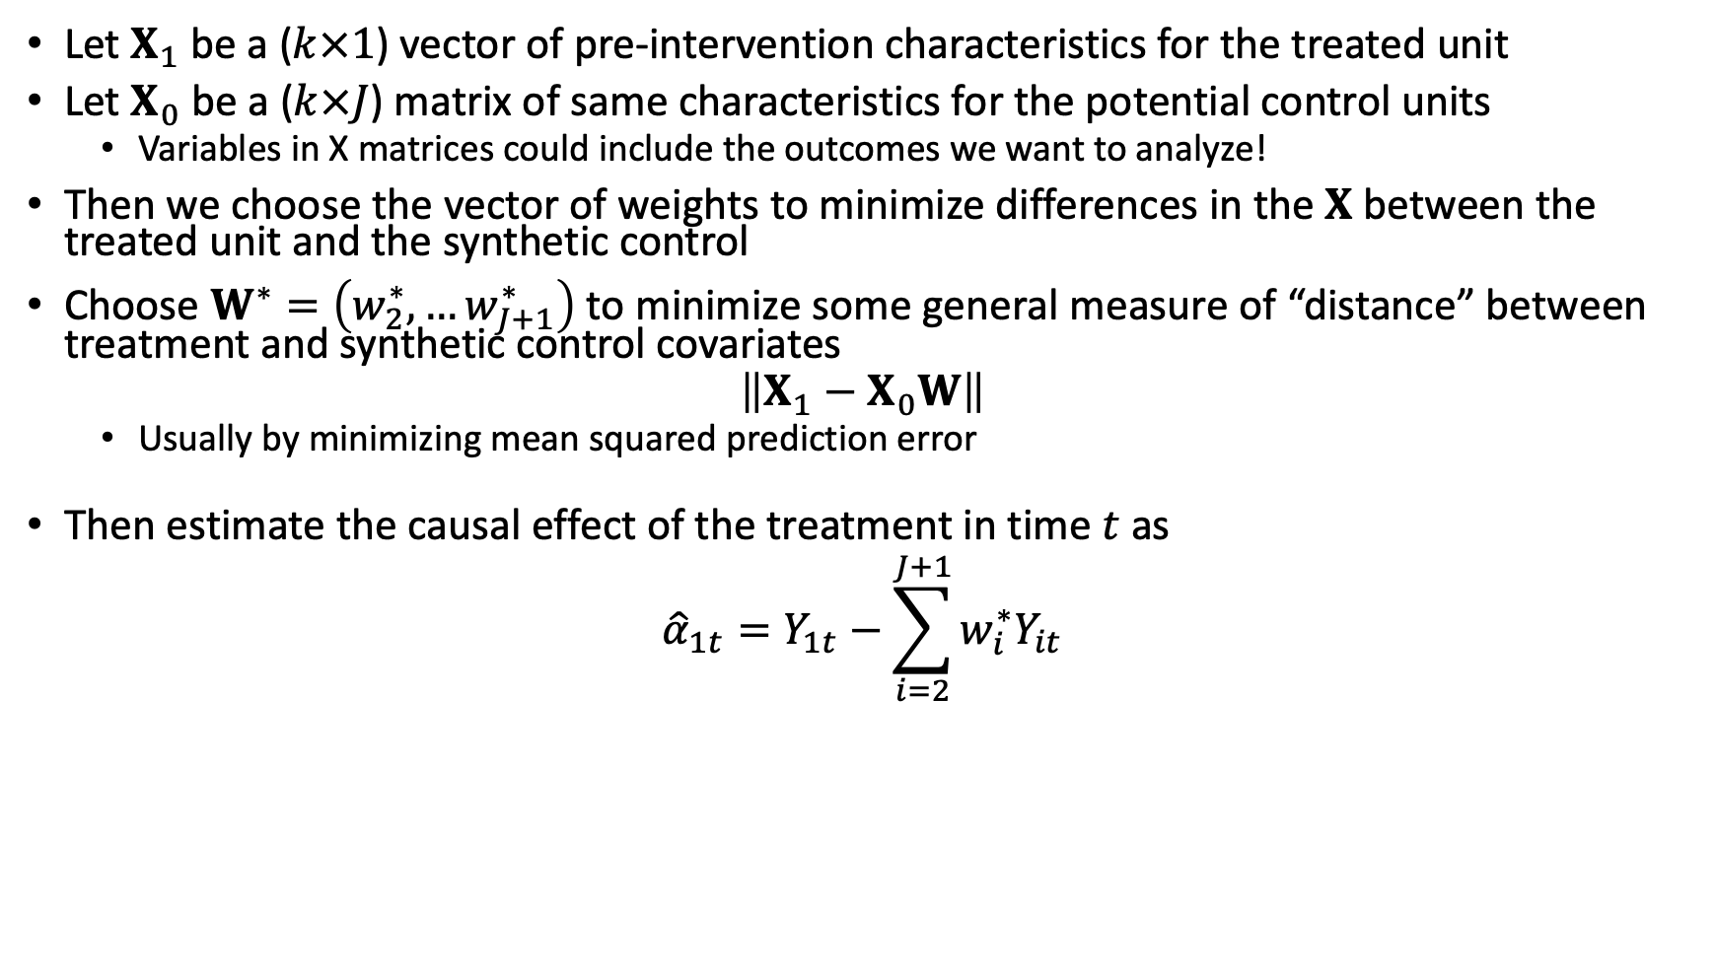
Diff-in-diff – Synthetic control
Let $X_{1}$ be a ($k×1$) vector of pre-intervention characteristics for the treated unit
Let $X_{0}$ be a ($k×J$) matrix of same characteristics for the potential control units
Variables in X matrices could include the outcomes we want to analyze!
Then we choose the vector of weights to minimize differences in the $X$ between the treated unit and the synthetic control
Choose $W^{∗}=\left(w_{2}^{∗},…w_{J+1}^{∗}\right)$ to minimize some general measure of “distance” between treatment and synthetic control covariates
$$\left\|X_{1}−X_{0}W\right\|$$
Usually by minimizing mean squared prediction error
Then estimate the causal effect of the treatment in time $t$ as
$${\hat{α}}_{1t}=Y_{1t}−\sum_{i=2}^{J+1}{w_{i}^{∗}Y_{it}}$$
Notes:
CIA

Slide 27
Overfitting and Validation
Model may be over fit – it performs very well in the pretreatment period due to chance
Particularly true if there are a lot of potential control groups and pretreatment time period is short
May bias results
Some strategies to address
Only fit model in training period subsample of the full pre-intervention period
Validate the fitted model by using it to predict outcomes in the data held back from fitting.
Use weights that preform well in both fit in training period and out of sample validation
Similar approach to machine learning approaches (i.e. causal forests)

Slide 28
Hypothesis testing
How likely is it we see the gap between treated group and synthetic control due to chance ?
Placebo approach – time dimension and space dimension
Try setting different random placebo “intervention” groups and times in control units
Estimate the “effect” of these fake intervention by creating synthetic controls form them from the other control groups.
Under assumption of no effect of the placebo “interventions” we get a distribution of observed “effects” under the null of no effect
Reject the null of no effect if estimated effect size for the treatment is outside the 95% confidence interval generated by the placebo effect distribution

Slide 29
Assumptions for Synthetic control methods
Availability of donor groups to construct controls. Similar to treatment group – driven by similar shocks
But did not get the treatment
Did not get large idiosyncratic shocks in the post-intervention period that did not affect the treatment group
Synthetic control matches actual outcome data closely in the pre-intervention period – testable
Size of the effect is large relative to noise
No anticipation of treatment
How would it affect selection of synthetic controls if the treatment group outcomes started to change before the policy change went into effect?
No spillovers of treatment effect between groups

Slide 30
Example
Research question: What was the effect of California’s Proposition 99 on cigarette sales?
Increased cigarette tax by 25 cents/pack
Tax revenues earmarked for anti-smoking education
Funded anti-smoking media campaigns
Clean indoor-air ordinances
Passed in 1988
Policy passed in only one state
Are there any states that make good “controls” for California?
Synthetic Control Methods for Comparative Case Studies: Estimating the Effect of California’s Tobacco Control Program (Abadie et al 2010)
Notes:
CIA

Slide 31
Synthetic Control Example
Step 1: Throw out 11 other states that passed similar tobacco control legislation (contaminates control)
Step 2: Decide which covariates predict post-period outcomes and should be used for determining synth control weights (minimize MSPE)
Step 3: Look at the weights assigned by the MSPE minimization
Are they “reasonable”? What might you consider reasonable?
If not, might reconsider whether you’re using the right variables to construct weights
Notes:
CIA

Slide 32
Synthetic Control Example

Slide 33
Synthetic control example
Synthetic control uses high-tech methods to get “right” counterfactual but you can still make nice visuals

Slide 34
Synthetic control example – event study

Slide 35
ITS and Synthetic Control example
You can also use synthetic control methods within ITS – situations where we might have just one treatment group
Example: Impact of tobacco taxes in South Africa
South Africa increased tobacco taxes considerably after 1994.
Advertising and smoking bans were implemented in 2001.
What was the effect on tobacco consumption?
Counterfactual – synthetic control from similar countries
Chelwa, Grieve, Corné van Walbeek, and Evan Blecher. "Evaluating South Africa's tobacco control policy using a synthetic control method." Tobacco Control 26.5 (2017): 509-517.

Slide 36
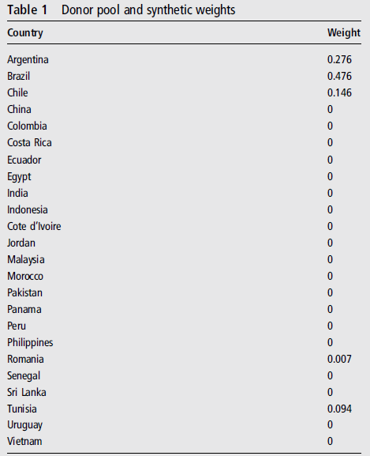
Synthetic Weights
Donor pool: other low and middle-income countries
Pattern of increasing affordability of cigarettes over the period (price/income per capita)
Donor pool excludes Thailand (and South Africa) and any countries with missing data
Variables: Per capita cigarette consumption (the outcome variable), real price of cigarettes, per capita real GDP, per capita alcohol consumption and the proportion of adults in the total population.
24 control countries

Slide 37
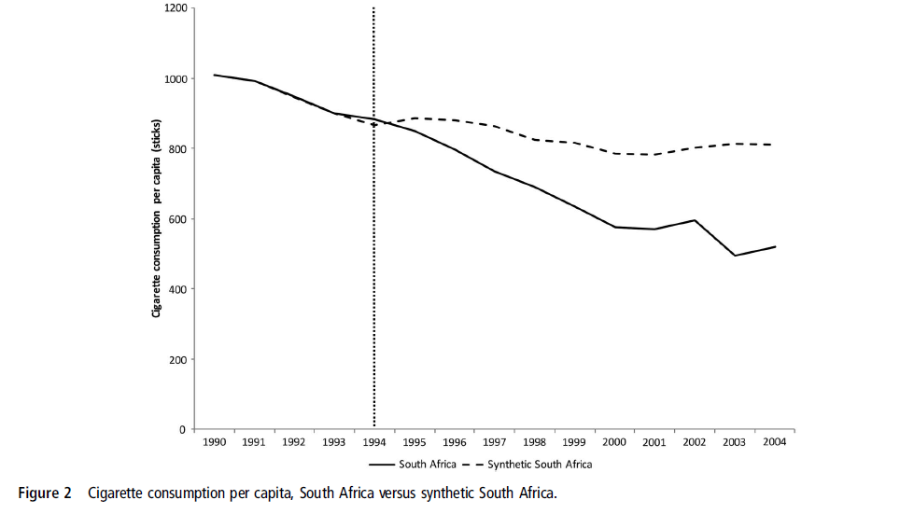

Slide 38
Summary – Synthetic Control
In settings with few treated units and few control units, synthetic control can be a powerful way to improve on diff-in-diff
Weights can be estimated before an intervention even begins; allows for pre-specification of counterfactual
If used to complement diff-in-diff or ITS: Be transparent! Show regular diff-in-diff / ITS and synth control estimates
Weights can be sensitive to specification choices – good to show different options
Requires a lot of high-quality pre-treatment data to get a good fit
Inference requires a variety of methods: placebo methods, randomization inference

Slide 39
Additional Slides

Slide 40
Formal difference in differences assumptions
Laura Hatfield has created a terrific website that provides a lot of formal detail surrounding difference in differences for health policy:
https://diff.healthpolicydatascience.org/
This website includes simulations you can play around with different assumptions and what they mean
Also contains lots of technical details about the different formal assumptions of DiD

Slide 41
Difference in Difference: Recommended readings
Fry CE, Hatfield LA. Birds of a feather flock together: Comparing controlled pre-post designs. Health Serv Res. 2021 Oct;56(5):942-952.
Causal inference: the Mixtape, Chapter 9
Angrist and Pischke (2009). Mostly Harmless Econometrics, Section 3.2.
Bertrand, Duflo, and Mullainathan (2004). How much should we trust difference-in-differences estimates? [Link]

Slide 42
Synthetic control: Recommended readings
Abadie, Alberto. "Using synthetic controls: Feasibility, data requirements, and methodological aspects." Journal of Economic Literature 59.2 (2021): 391-425.

